Slide 1
Retail Data Analysis
-By Kavya Boban

Slide 2
Introduction
People tend to buy more things before a festive season than during a normal, non-holiday week. So the revenue earned by the shop can increase if there is a good estimate about the seasons that can give a profit and plan accordingly.
If a shop has too few products before the festive season, it will lose potential income. But if a shop has too many products, too much storage would be required and storage also costs money, so the company would again lose money. Therefore an analysis is required for smooth functioning of the shop without loss.

Slide 3
Project Description
The proposed system can therefore be used in order to optimize the production of products, such that there is always an optimal amount available. The proposed system RDA is used nowadays by shops in order to better predict the number of products, that might get sold and therefore to better estimate how much product should be produced.

Slide 4
Relevance of topic
By the development of the system the organization can easily predict the weekly sales for a store and visualize the data for better insight .
This should then help to optimize the manufacturing process and thereby help to increase income while lowering costs.

Slide 5
Datasets
1. Stores
Anonymized information about the 45 stores,
indicating the type and size of store

Slide 6
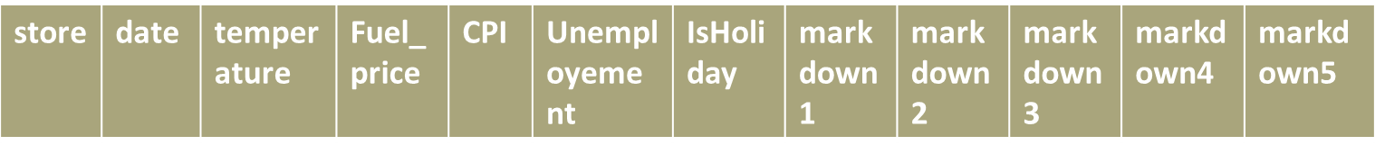
Features
Contains additional data related to the store, department, and regional activity for the given dates.
Store - the store number
Date - the week
Temperature - average temperature in the region
Fuel_Price - cost of fuel in the region
MarkDown1-5 - anonymized data related to promotional markdowns. MarkDown data is only available after Nov 2011, and is not available for all stores all the time.
CPI - the consumer price index
Unemployment - the unemployment rate
IsHoliday - whether the week is a special holiday week

Slide 7
Sales
Historical sales data, which covers to 2010-02-05 to 2012-11-01. Within this tab you will find the following fields:
Store - the store number
Department - the department number
Date - the week
Weekly_Sales - sales for the given department in the given store
IsHoliday - whether the week is a special holiday week

Slide 8
Modules
Data pre-processing
Visualization
Model training
Model evaluation

Slide 9
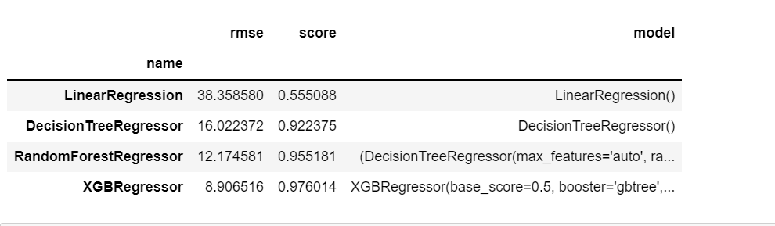
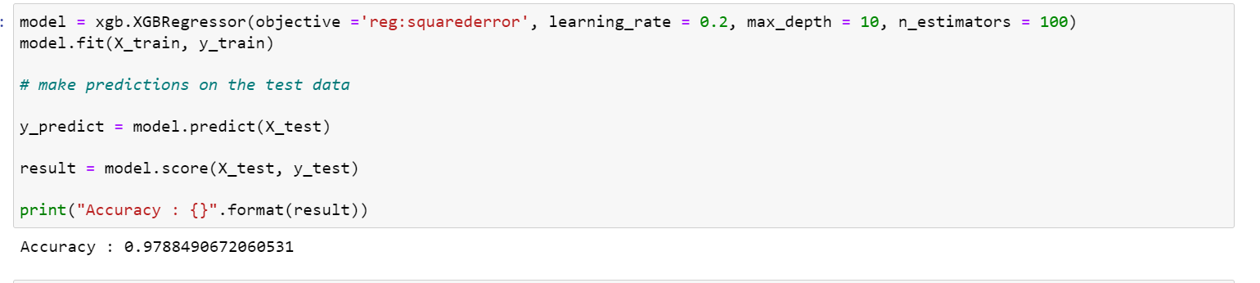
Algorithms Used
Linear Regression
Random Forest
Decision Tree
XGBoost
ACCURACY

Slide 10
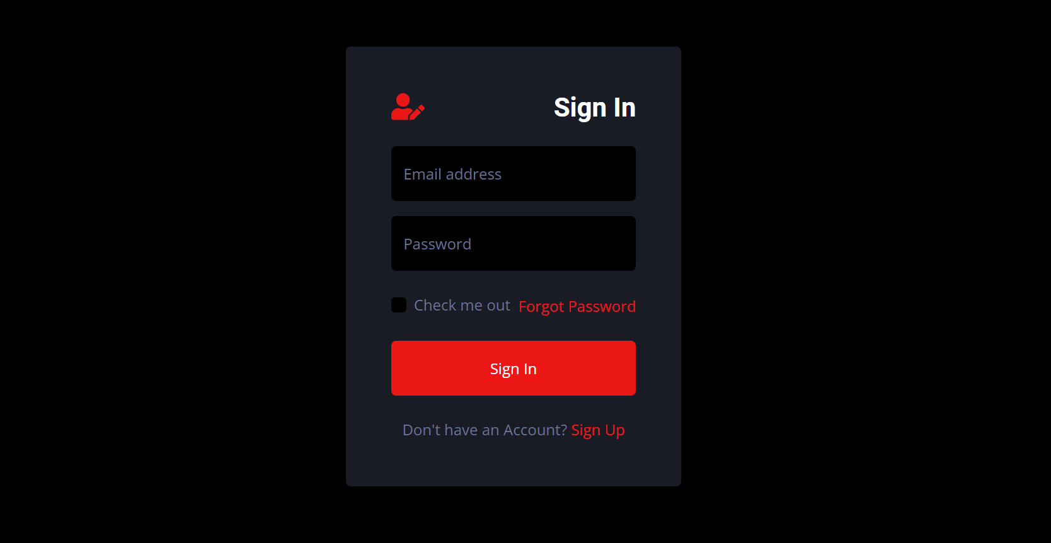
UI -screenshots

Slide 11
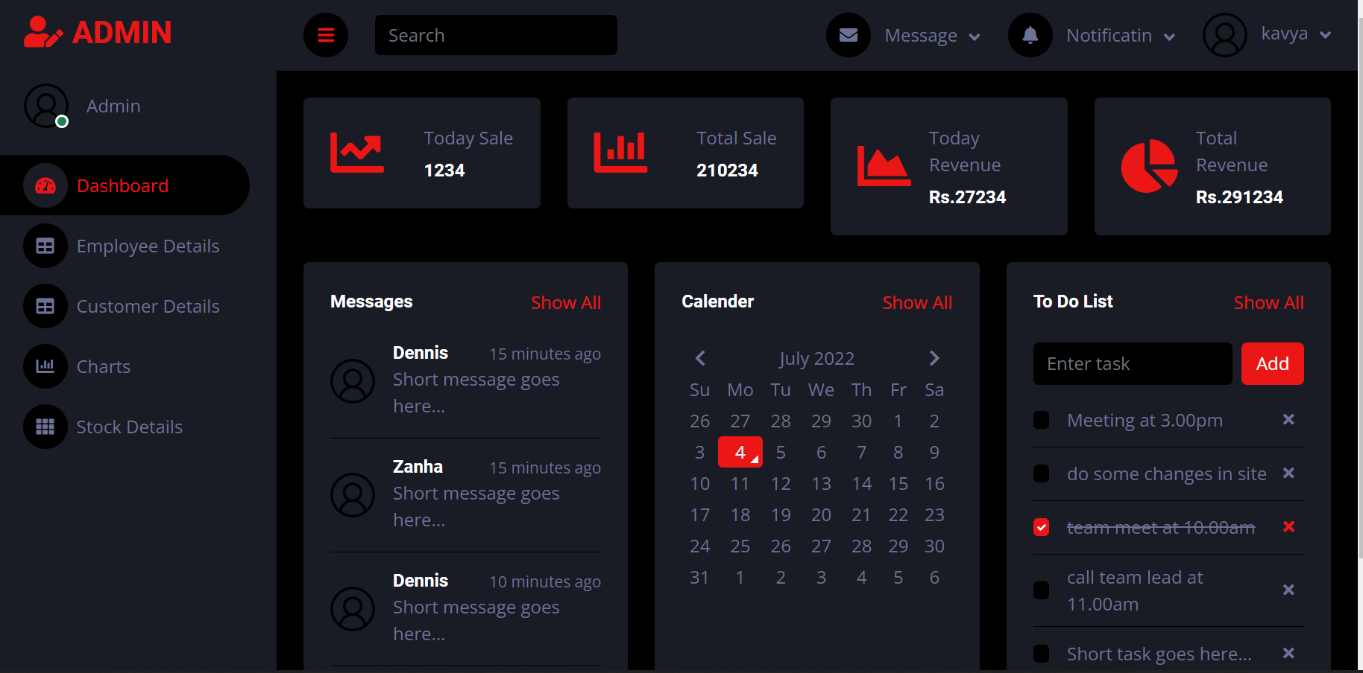

Slide 12
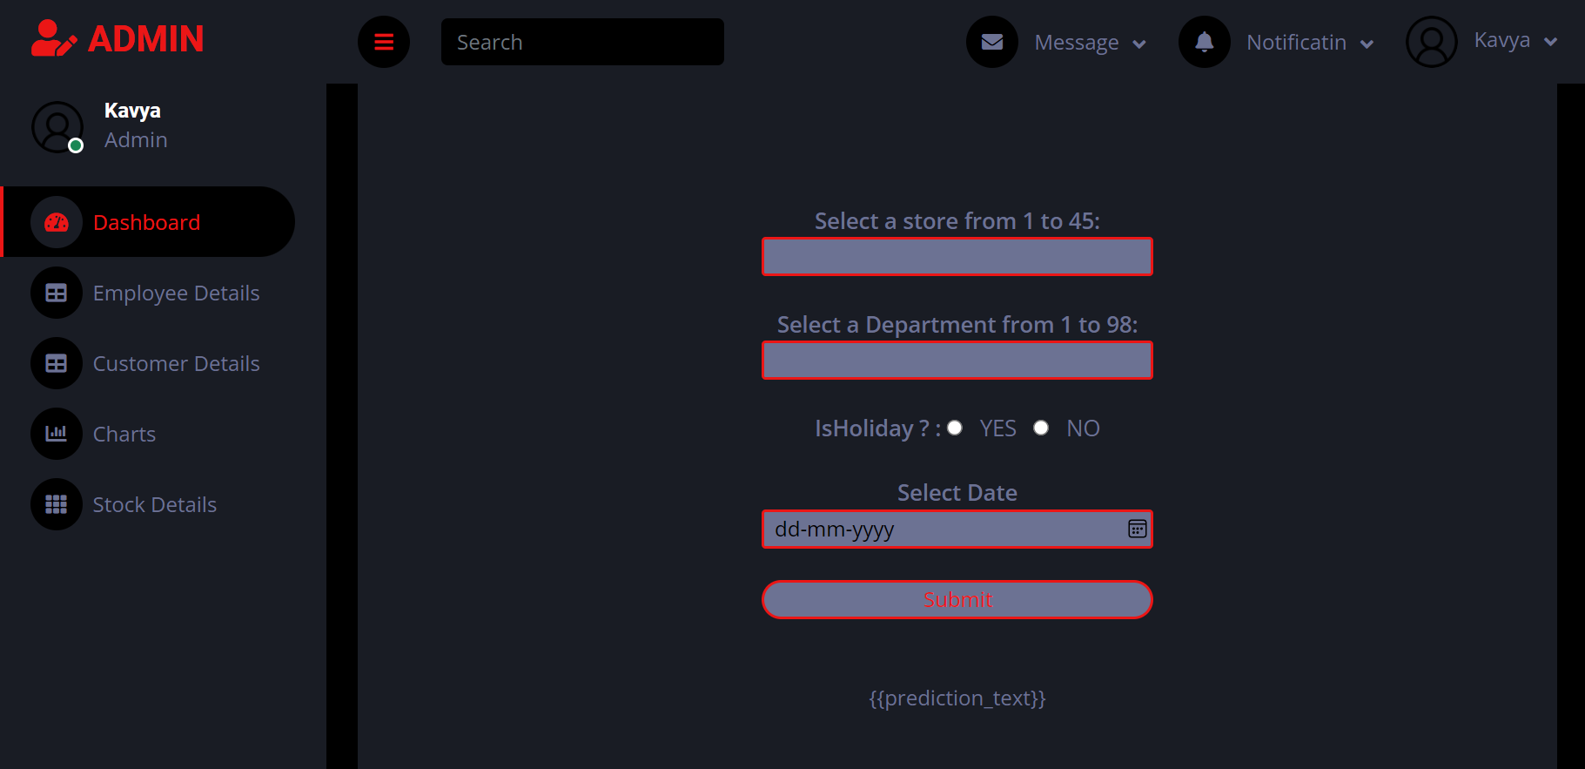

Slide 13
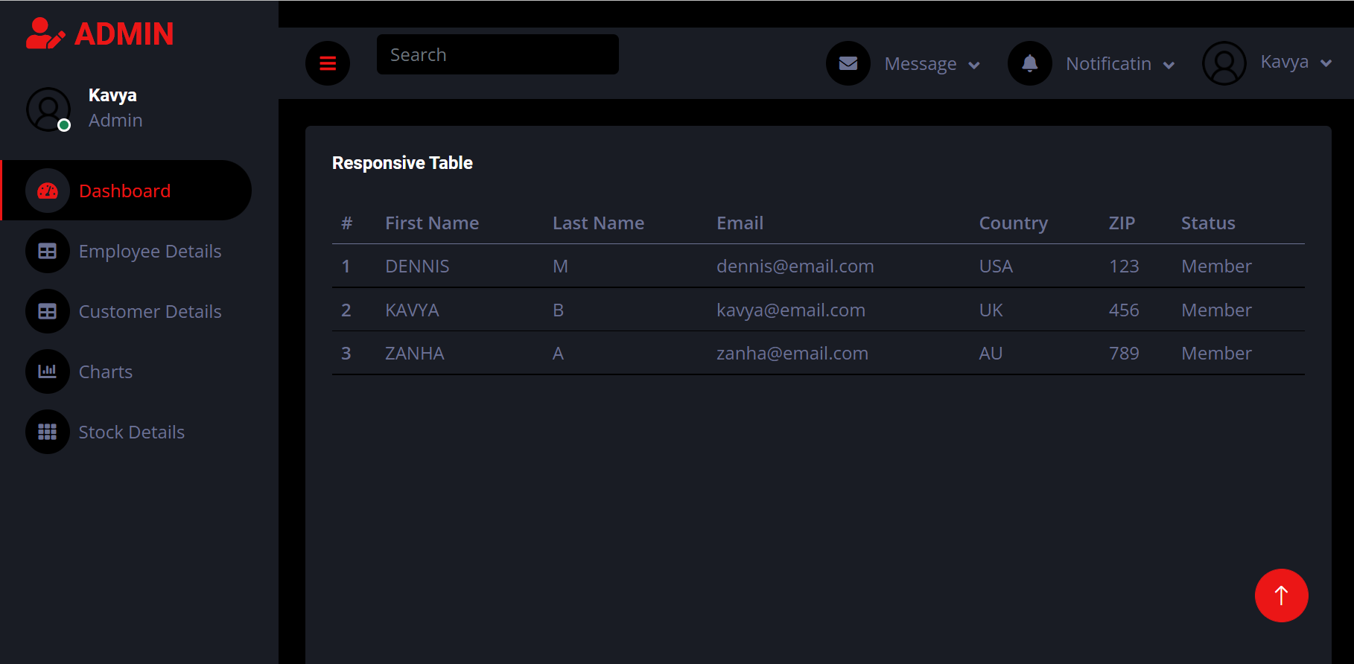

Slide 14
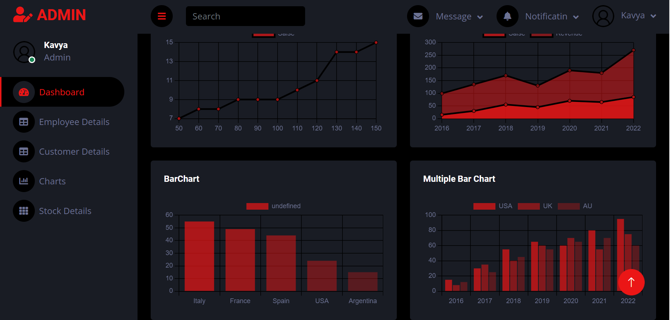

Slide 15
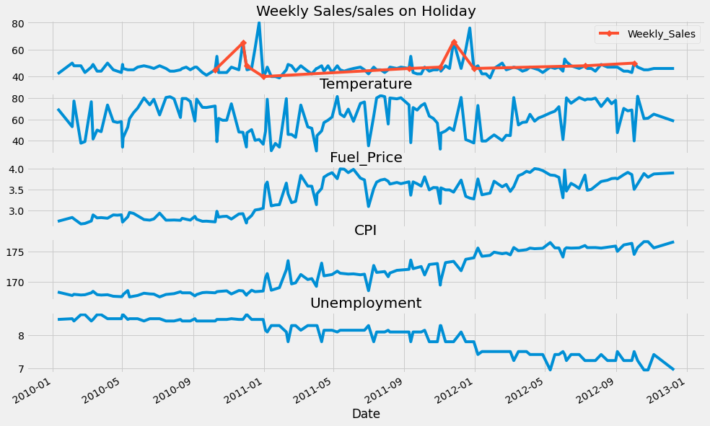
Visualization Screenshots
Nov- Dec shows spike in Weekly Sales.but over the year it is not increased.
weeks nearby holiday shows peak
Fuel Price and Consumer Price Index shown growth over the year.
Unemployment decreased year after year.
Temperature is showing a random walk

Slide 16
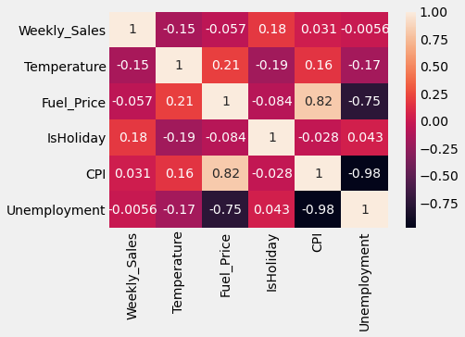
Weekly sales doesnot show any high correlation with any other parameters.
CPI and Unemployment shows negative correlation on other hand Fuel Price show positive correlation
Unemployment and Fuel price are also negatively correlated

Slide 17
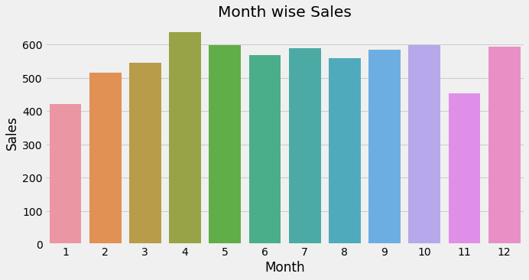
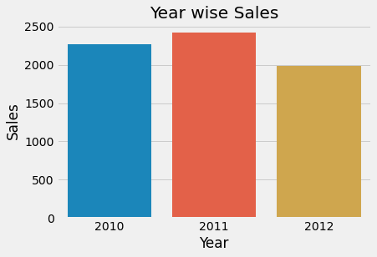
It could be as Enough buying during offer and holidays (Black friday Sales,Chrismas,New year) and later sales go down and then again gaining momentum in some months.
In Nov also people show less buying can be waiting period for upcoming sales.
whole data for Dec-2013 I guess is not available so even after spike in Dec the sales are not gone very high.

Slide 18
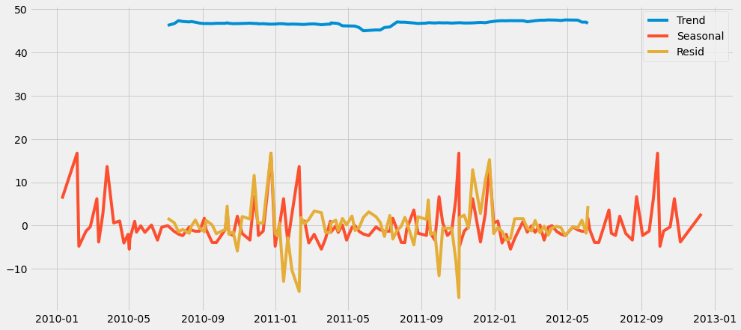
It shows a sideway trend

Slide 19
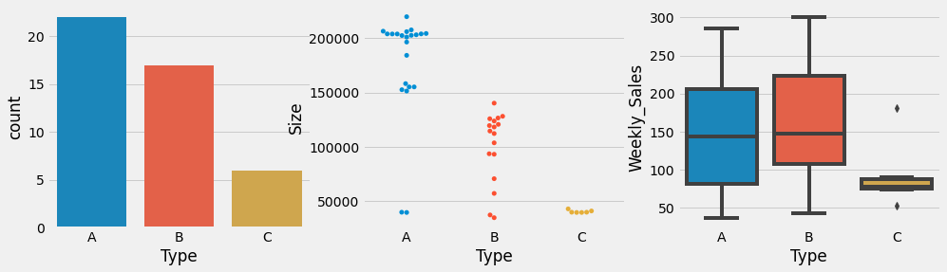
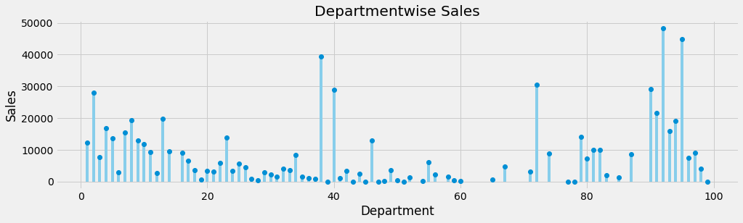
Store Count is in the order of A, B and least is C
Size wise A store as most no of Item followed by B and than C
Even After less Count of Store and lesser Size B has more Weekly Sales than A and C at the least
Here we can see department 1-15 as well as 90-95 has shown higher weekly sales.
some department as 38,40,72 has shown higher weekly sales.

Slide 20
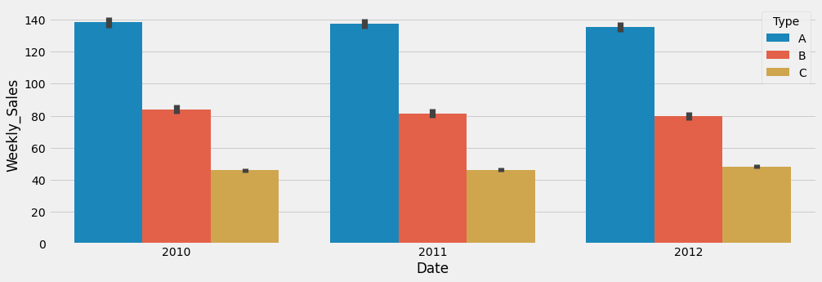
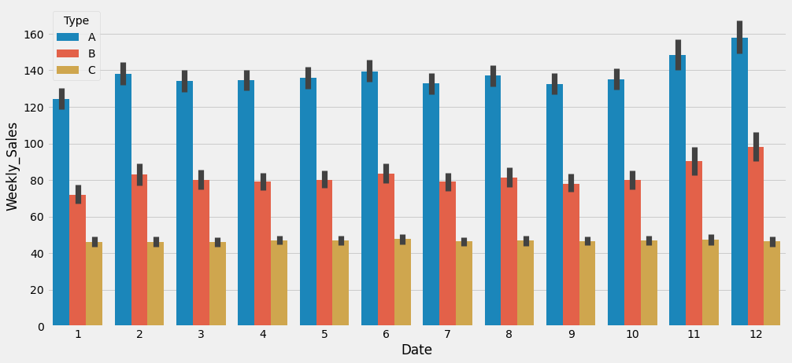
Store Type A & B has shown slight decrease year on basis in sales.
Store C has shown a slight increase in sales.
Type A & B store show spike in Nov Dec mostly due to holiday whereas jan has shown decrease in sale.
Type C is consistent over every month and doesnot show much deviation

Slide 21
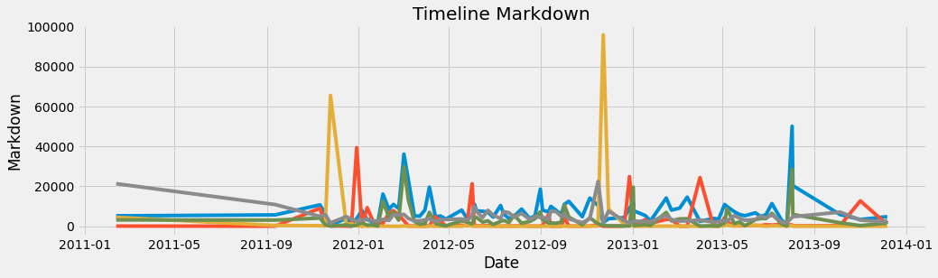
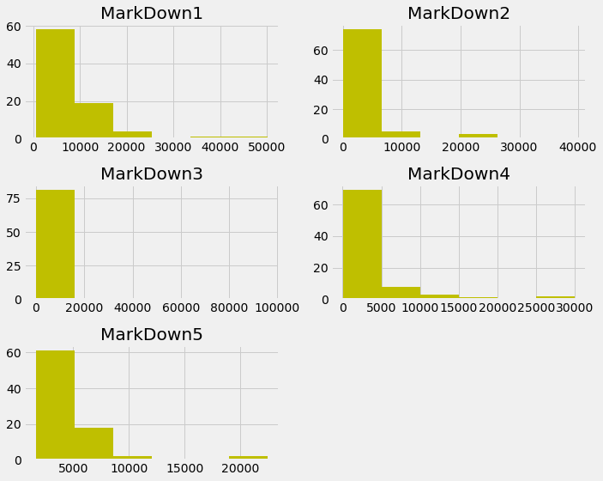
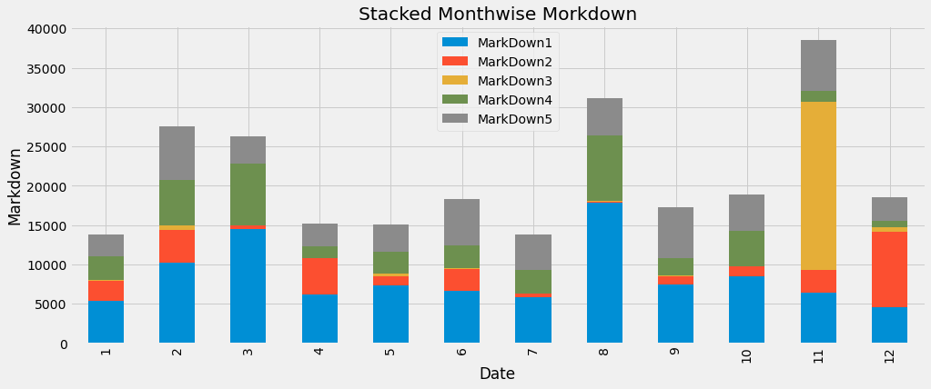

Slide 22
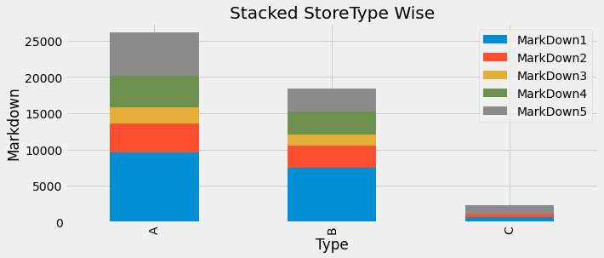

Slide 23
THANK YOU

